Slide 1
BCOG 100
Spatial Cognition
Lecture 3: Neurobiological Implementation

Slide 2
Reading Check 8-3
Password: hippocampus
Question: Do you have good or bad spatial cognition? Tell me about it.

Slide 3
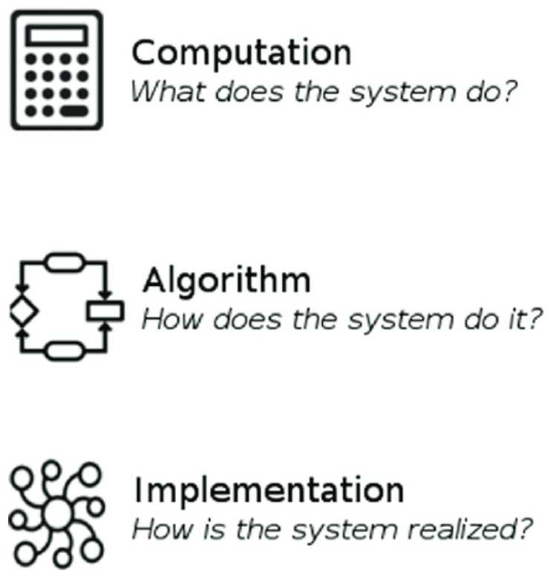
Neurobiology of Spatial Cognition
Recap & Overview
Last Time:
Representation and Algorithms for Spatial Cognition
Today:
From abstract models to neural systems
How brains build and update internal maps
How spatial circuits evolved into memory systems
Notes:
Last time, we looked at how minds and machines represent and compute space — the algorithms that let an organism build and use a map of its world.
Today, we turn to how those computations are realized in the brain itself.
We’ll start by tracing the earliest neural mechanisms for orientation and motion — circuits that appeared long before mammals and that already integrated sensory and movement signals.
Then we’ll see how those systems evolved into the hippocampal and entorhinal networks that give rise to the place, grid, and head-direction cells discovered in the late twentieth century.
From there, we’ll follow how these neural codes interact, how they update with experience, and finally how they laid the groundwork for something even more powerful: memory.
Because the same circuitry that once helped animals find their way through space later became the system that lets humans navigate their past and imagine possible futures.
By the end of today’s lecture, you should see how “maps in the brain” are not just about location — they’re a general solution for organizing experience across space, time, and meaning.

Slide 4
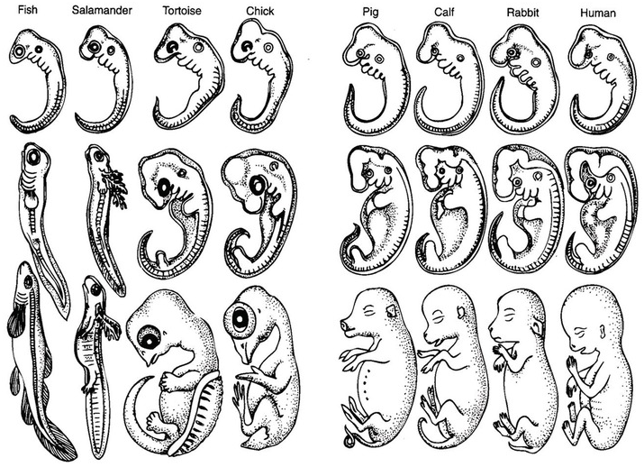
Neurobiology of Spatial Cognition
Evolutionary Continuity: From Fish to Mammals
Spatial cognition builds on ancient orientation systems
Early vertebrates integrated motion and sensory cues
Modern hippocampal circuits extend those same principles
Notes:
The brain’s ability to represent space didn’t appear suddenly
—it evolved by expanding systems that were already solving simpler orientation problems.
Even in early fish, neural circuits in the brainstem, cerebellum, and vestibular system
combined information about body rotation, linear acceleration, and optic flow to stabilize movement.
These systems let fish distinguish self-motion from motion in the world
—the same computational challenge we discussed at the functional level.
As vertebrates moved onto land, those mechanisms became more complex.
The addition of larger forebrain regions allowed sensory and motion information to be integrated over longer timescales,
giving rise to primitive internal maps
—representations not just of instantaneous direction but of position within an environment.
The hippocampus, which would later become central to memory in mammals,
began as one of these spatial-processing centers.
In early reptiles and amphibians, its neural organization already supported mapping-like functions,
such as home-range navigation and landmark-based foraging.
So when we study the mammalian hippocampus, we’re not looking at something uniquely human or even uniquely mammalian.
We’re seeing the elaboration of an ancient system that started as a solution for orientation and motion control,
and gradually evolved into a powerful machinery for mapping, planning, and remembering.

Slide 5
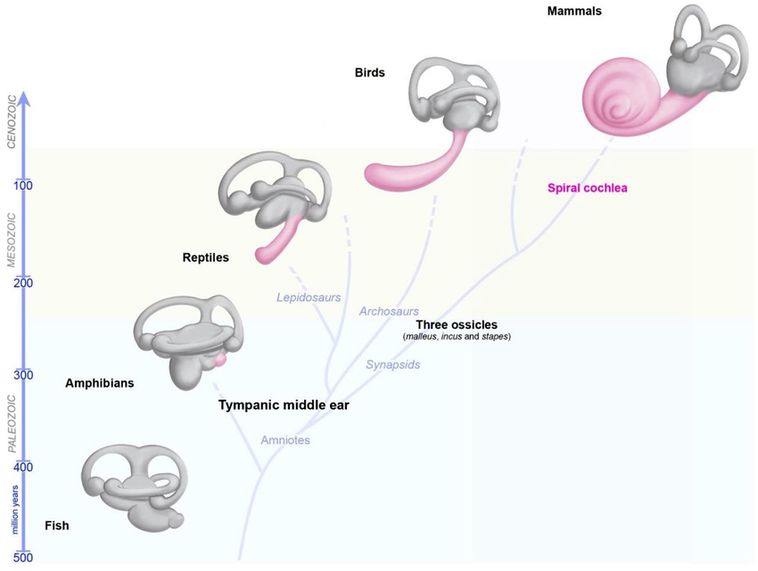
Neurobiology of Spatial Cognition
Early Neural Foundations: Stabilizing Movement and Orientation
Vestibular, cerebellar, and brainstem circuits integrate motion signals
Different senses must agree for stable orientation
Foundation for distinguishing self-motion from world motion
Notes:
Before animals could build maps of the world, they had to solve a more basic problem:
keeping track of how their bodies were moving through it.
This required coordinating signals from multiple sensory systems so that motion felt stable and predictable.
The vestibular system detects rotation and linear acceleration using small canals in the inner ear
— or their evolutionary precursors in aquatic vertebrates.
Those signals are sent to the brainstem and cerebellum,
which combine them with information from vision and proprioception.
If the signals line up, the animal can tell that the world is stationary and it is the one moving.
If they conflict — as in spinning or motion sickness — orientation quickly breaks down.
This integration is what allows fish to swim in straight lines,
frogs to leap toward targets, and birds to keep their gaze fixed in flight.
It’s also the foundation of path integration: the ability to estimate displacement based on velocity and direction over time.
From an evolutionary perspective, these circuits set the stage for everything that follows.
They established the principle that different sensory modalities must be combined
into a single coherent estimate of self-motion
— a principle the hippocampus will later extend to construct full-blown spatial maps.

Slide 6
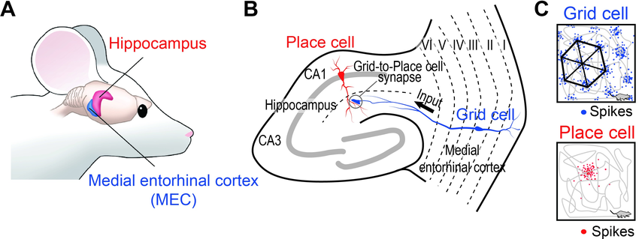
Neurobiology of Spatial Cognition
Place Cells: The Neural Map of Space
Vestibular, cerebellar, and brainstem circuits integrate motion signals
Different senses must agree for stable orientation
Foundation for distinguishing self-motion from world motion
Notes:
n 1971, John O’Keefe and Jonathan Dostrovsky made a discovery that changed how we think about the brain.
Recording from single neurons in the hippocampus of freely moving rats,
they found cells that fired only when the animal was in a specific location
—say, the southwest corner of a box or along one wall of a corridor.
Each of these neurons had what O’Keefe called a place field
—a preferred location in the environment where its activity peaked.
If the rat moved to a different spot, the cell went silent, and another one took over.
Taken together, thousands of these neurons created a distributed pattern of activity
that corresponded to the rat’s current position.
This was a stunning finding.
It suggested that the hippocampus contains an internal map
—not a sensory image of the world, but an abstract code for spatial position.
The brain wasn’t just reacting to stimuli; it was representing where the animal was in an invisible coordinate system.
O’Keefe later called this system a “cognitive map”, borrowing Tolman’s term from psychology.
It showed that the hippocampus, long known for its role in memory,
might actually be a navigation system at its core
—a structure that constructs and maintains a mental representation of space.

Slide 7
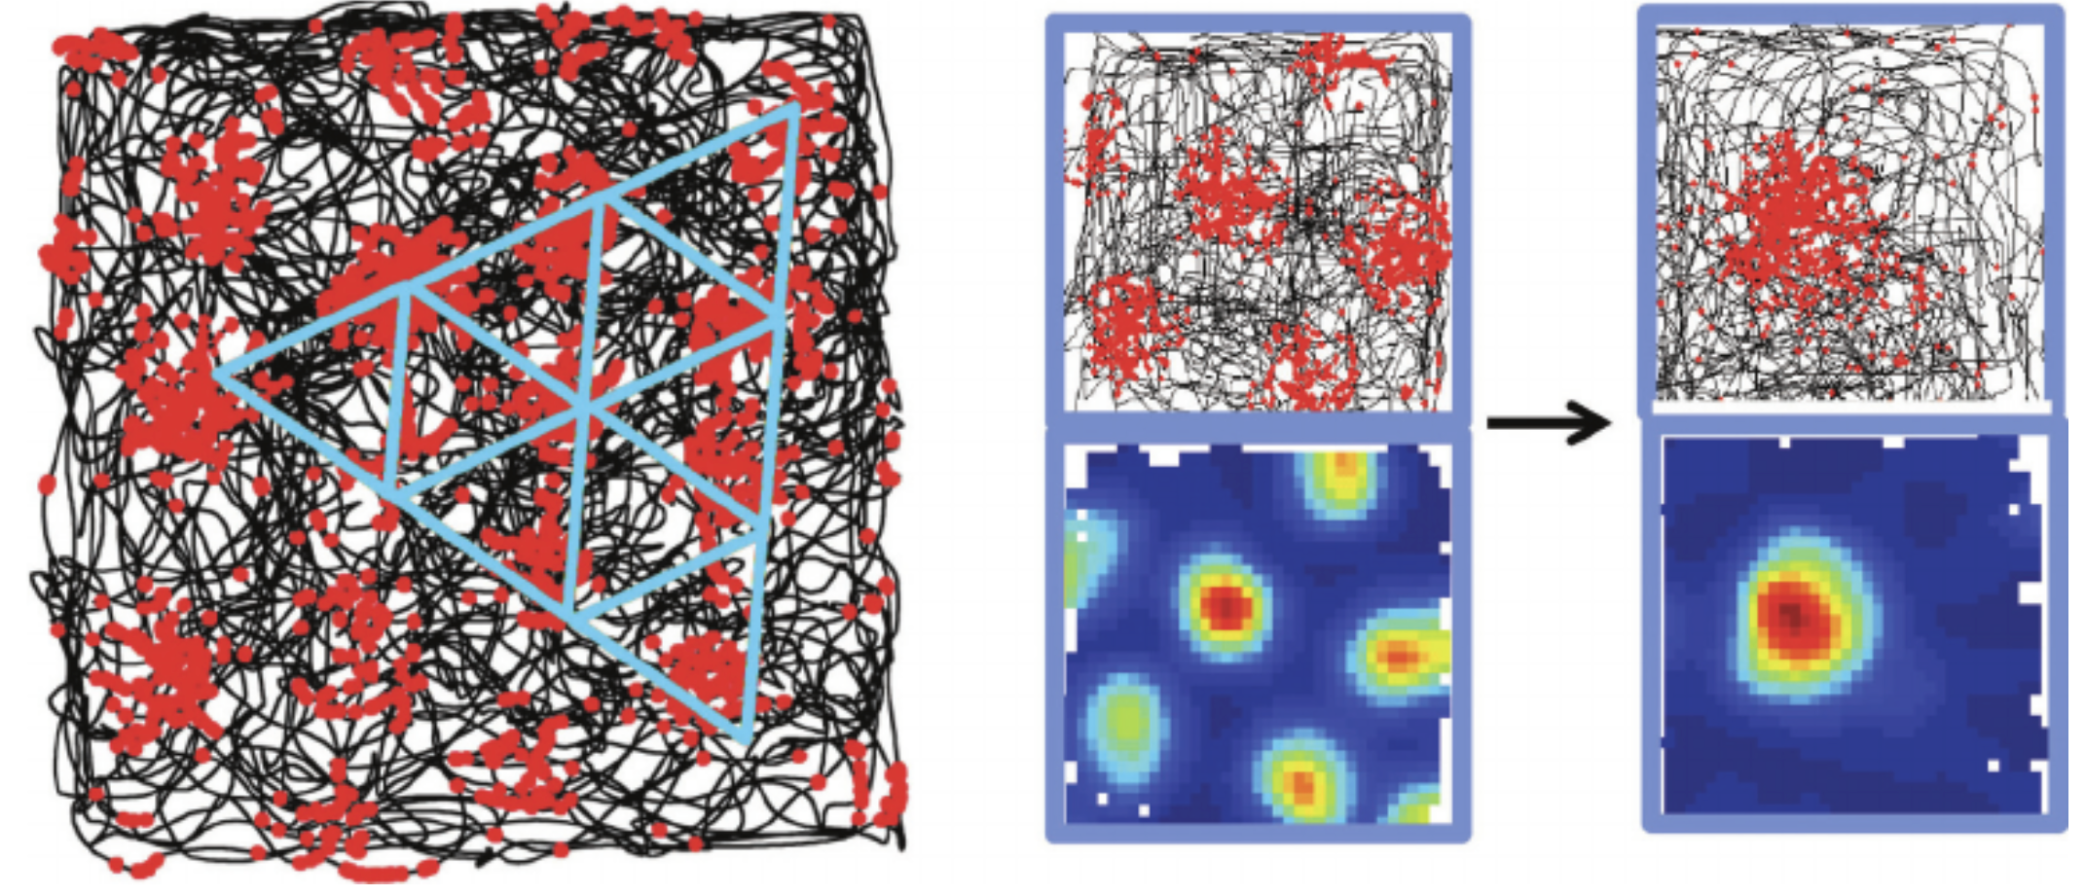
Neurobiology of Spatial Cognition
Grid Cells: The Brain’s Internal Coordinate System
Moser & Moser (2005): entorhinal neurons fire in hexagonal patterns
Each grid cell marks locations at regular spatial intervals
Provides a built-in metric for distance and direction
Notes:
More than thirty years after O’Keefe’s discovery of place cells, a second major breakthrough completed the picture.
In 2005, May-Britt and Edvard Moser discovered grid cells in the entorhinal cortex, a region that feeds into the hippocampus.
When they recorded from rats exploring an open arena,
they found cells that didn’t respond to a single place but to multiple locations, arranged in a remarkably regular pattern.
Each cell fired whenever the animal’s position formed a vertex in an invisible hexagonal grid that tiled the entire environment.
The pattern was so consistent that it looked like the brain had constructed its own internal coordinate system.
Different grid cells had different spacing and orientations,
allowing the brain to represent both fine and coarse spatial scales simultaneously.
Together, these cells provided a built-in metric
—a way to measure distance and direction independent of landmarks.
This discovery helped explain how the hippocampus could maintain a stable spatial map even when sensory cues were minimal or ambiguous.
Place cells told the brain where you are; grid cells told it how far you’ve moved and in what direction.
It was the neural equivalent of combining a GPS pin with a compass and odometer.
The Mosers’ work earned them the Nobel Prize in 2014,
shared with O’Keefe, for showing how these interacting systems create a neural representation of space
—an internal geometry woven directly into the brain’s wiring.

Slide 8
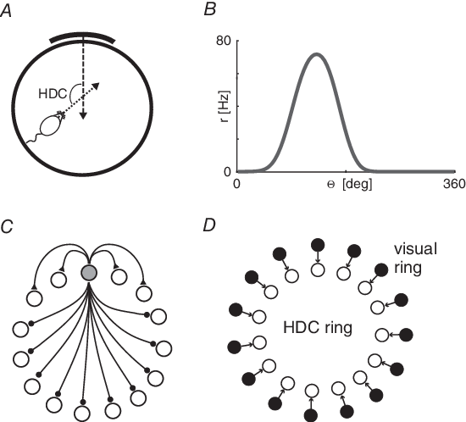
Neurobiology of Spatial Cognition
Head-Direction and Boundary Cells: Orientation and Limits
Head-direction cells encode facing orientation
Boundary cells fire near environmental edges
Together they anchor spatial maps to stable reference frames
Notes:
Place and grid cells tell the brain where it is,
but navigation also requires knowing which way you’re facing and where the boundaries are.
Two additional cell types provide those signals.
Head-direction cells, first discovered in the early 1990s,
fire whenever an animal’s head points in a particular direction
—north, south, east, or west relative to the external frame of the environment.
That “external frame” can come from stable landmarks, the geometry of the space, or other global cues.
Even when those cues disappear, the cells maintain their orientation for a while using vestibular and motor information, though they eventually drift until external references recalibrate them.
In that sense, they act like a biological compass, combining internal and external information to provide a continuously updated sense of heading.
Boundary or border cells add another piece.
These neurons, found in the entorhinal cortex and subiculum,
fire when the animal is near the edge of an environment—like a wall, cliff, or barrier.
They define the limits of navigable space and help stabilize grid and place activity
by anchoring the map to external structure.
Together, these cell types create a complete spatial reference system:
– Grid cells provide an internal coordinate frame,
– Place cells mark specific locations,
– Head-direction cells maintain orientation, and
– Boundary cells define the edges.
The brain doesn’t just store a static map—it maintains a dynamic, self-updating model
of position, direction, and environmental layout, continuously calibrated as the organism moves.

Slide 9
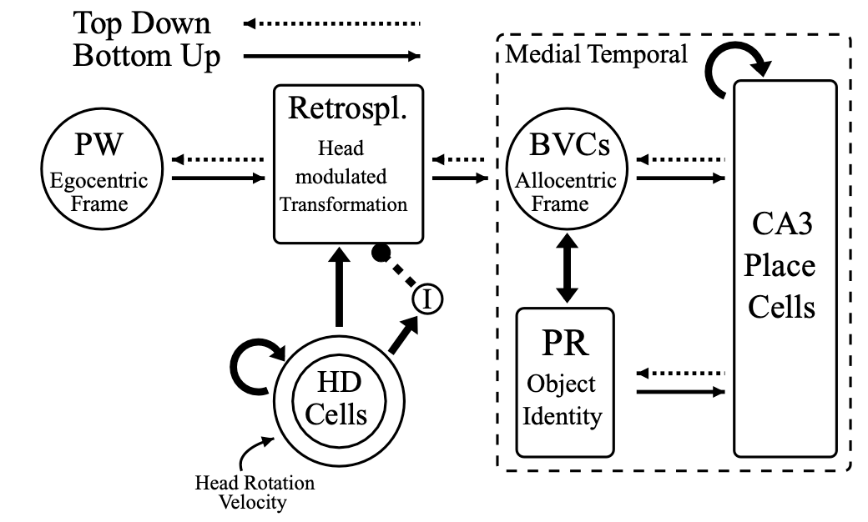
Neurobiology of Spatial Cognition
Interacting Systems: Building a Coherent Spatial Map
Hippocampus and entorhinal cortex form a shared navigation circuit
Place, grid, head-direction, and boundary cells work together
Integration creates a stable, self-correcting map of space
Notes:
Each of these specialized cell types contributes one piece of the navigation puzzle, but none of them work alone.
They’re part of an interconnected network spanning the hippocampus, entorhinal cortex, and subiculum
—a system that transforms sensory and movement signals into a unified spatial model.
Grid cells in the entorhinal cortex provide a coordinate framework — a kind of background geometry.
Place cells in the hippocampus use that framework to tag specific locations,
enriched by sensory and contextual cues.
Head-direction cells keep the coordinate frame aligned with real-world orientation,
while boundary cells lock it to the physical edges of the environment.
Information flows both ways between these structures.
The entorhinal cortex supplies the hippocampus with continuous spatial metrics,
while the hippocampus sends feedback that refines and stabilizes grid patterns.
This loop keeps the system coherent even when some inputs are noisy or missing.
As a result, the spatial map is both stable and adaptive—it drifts when sensory cues are lost,
then snaps back into alignment when landmarks reappear.
It’s not a static image but a dynamic simulation
—an ongoing computation that integrates motion, feedback, and memory into a single sense of “where we are.”

Slide 10
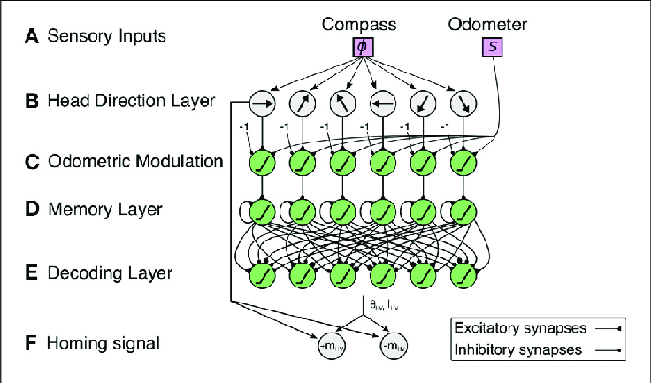
Neurobiology of Spatial Cognition
Neural Mechanisms of Path Integration
Grid and head-direction cells track movement through space
Velocity and orientation signals update the map
Landmarks recalibrate drifting internal estimates
Notes:
In Lecture 2, we saw that animals can estimate their position by integrating how far and in what direction they’ve moved — even without external cues.
Here’s what that looks like in the brain.
As an animal moves, head-direction cells provide a continuously updated compass bearing.
At the same time, velocity-sensitive inputs from motor and vestibular systems feed into grid cells in the entorhinal cortex.
Each step or rotation slightly shifts the pattern of grid-cell activity, effectively updating the animal’s internal coordinates.
This neural shift is the biological implementation of path integration.
But, just like in behavior, errors accumulate.
If grid and head-direction cells run open-loop too long, their estimates drift — the animal’s “mental position” slowly diverges from reality.
When stable landmarks appear, place cells in the hippocampus help snap the system back into alignment.
The interplay between self-motion signals and external cues keeps the map both flexible and anchored.
So the same principles we discussed earlier—prediction, feedback, recalibration—are visible here at the neural level.
Path integration isn’t a separate process; it’s the moment-to-moment updating of the spatial map itself.

Slide 11
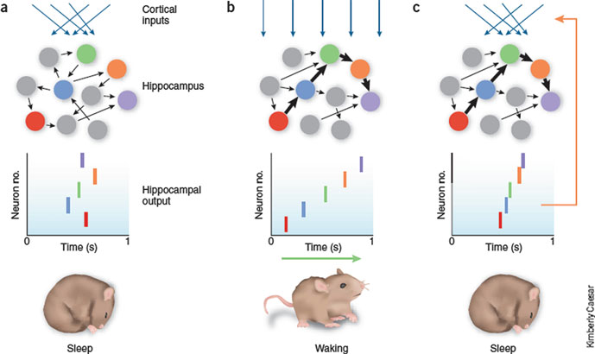
Neurobiology of Spatial Cognition
Replay and Pre-play: Planning and Prediction in the Hippocampus
Hippocampal “place cells” reactivate during rest and sleep
Replay: past trajectories repeated in fast sequence
Pre-play: upcoming paths simulated before movement
Notes:
Once neuroscientists could record from many hippocampal neurons at once, a striking pattern emerged.
When rats paused or rested after exploring a maze, the same place cells that had fired along the path reactivated
— in the same sequence, but compressed in time.
This phenomenon, called replay, showed that the brain doesn’t just record experience
— it replays it, as if rehearsing the route internally.
Decades earlier, the psychologist Edward Tolman had guessed something like this might be happening.
Watching rats pause at a maze intersection,
he noticed them moving their heads back and forth and described it as “vicarious trial and error”
—as if they were mentally running through the possible routes before choosing one.
Modern recordings show that during those very pauses,
hippocampal cells do fire in sequences corresponding to each potential path
—essentially confirming Tolman’s intuition at the neural level.
Even more intriguing was pre-play: before the animal actually took a new path,
certain place cells fired in the order that matched the upcoming trajectory.
In other words, the hippocampus was simulating possible futures before acting
— using the same mapping machinery that encoded past experiences.
Replay and pre-play bridge navigation, planning, and memory.
They let the brain test possible paths, consolidate learned ones, and perhaps imagine alternatives.
During sleep, these compressed sequences are thought to help transfer spatial experiences into longer-term memory in the cortex
— turning momentary navigation into enduring knowledge.
So the same neural map that guides movement through space can also guide thought through time
— predicting, recalling, and recombining experiences in imagination.

Slide 12
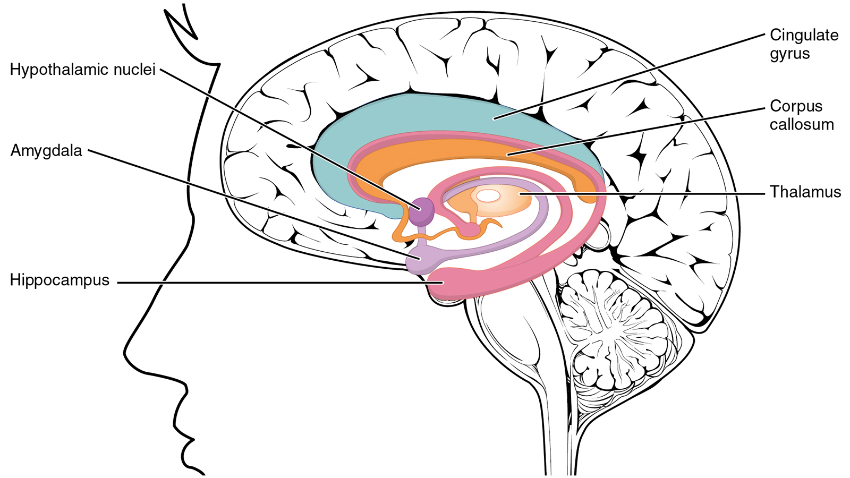
Neurobiology of Spatial Cognition
From Navigation to Memory
Spatial mapping and episodic memory share the same circuitry
The hippocampus links where, when, and what happened
Navigation through space became navigation through experience
Notes:
The discovery of replay and pre-play helped reveal something profound:
the neural machinery for navigation also supports memory.
The hippocampus doesn’t just encode where we are—it also records what happened there, and when.
Each experience becomes anchored in space and time.
When you recall a walk through your neighborhood or your first day at college,
your memory unfolds as a kind of internal journey through scenes and locations.
In animals, hippocampal firing patterns that once represented physical places are reused to represent episodes
—events arranged in sequence, each tied to a context.
This overlap explains why patients with hippocampal damage lose both navigation and episodic memory:
they can’t remember paths through a maze, or through their own lives.
Evolutionarily, it makes sense.
A system that could keep track of location and trajectory would be a perfect foundation for remembering where things happened
—and eventually, what happened when.
Spatial mapping became temporal mapping; navigation became narrative.
The same network that lets a rat plan its next turn also lets humans mentally retrace a story or imagine a future event
—turning a map of space into a map of experience itself.

Slide 13
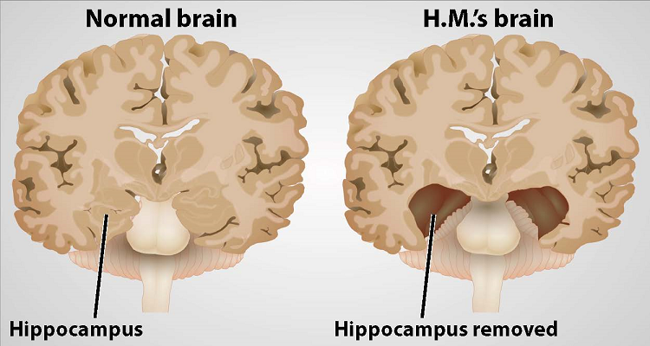
Neurobiology of Spatial Cognition
Lesions and Imaging Evidence
Hippocampal damage impairs both navigation and episodic memory
Imaging shows spatial and memory tasks activate overlapping regions
Reactivation reinstates the context of past experience
Notes:
If the hippocampus underlies both navigation and memory, we should expect damage to it to disrupt both—and that’s exactly what we see.
Classic neurological cases, like patient H.M., showed profound amnesia after hippocampal removal.
But other patients with smaller, selective damage lose not only new memories but also their sense of spatial orientation—they can’t form new maps or recall familiar routes.
Functional imaging tells the same story.
When people navigate a virtual maze, recall a personal memory, or imagine a future event, the same hippocampal regions activate.
London taxi drivers, whose work requires detailed spatial knowledge, show enlarged hippocampi, and their activity patterns predict navigation skill.
One of the most compelling findings is that recalling a memory reinstates the sensory and spatial context in which it was formed.
For example, if you pause a podcast, then later replay a short segment you’ve already heard, your brain doesn’t just recognize the words—it spontaneously reactivates the scene of where you were the first time you heard them.
That’s the hippocampus pulling up the associated spatial map and binding it back to the current experience.
In other words, memory retrieval is a kind of mental navigation: moving through an internal space of events, guided by the same neural compass that once tracked your position in the world.

Slide 14
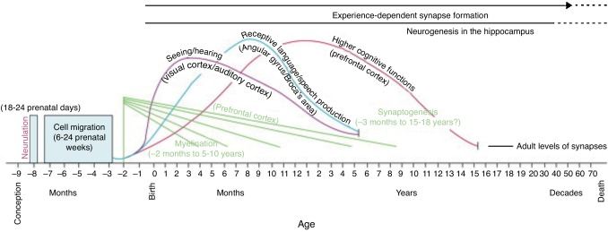
Neurobiology of Spatial Cognition
Development of Spatial Maps
Children’s spatial abilities and episodic memory develop in parallel
Allocentric mapping emerges gradually across early childhood
Reflects hippocampal maturation and experience-driven learning
Notes:
The link between spatial mapping and memory isn’t just seen in adults—it’s built over development.
Infants and young children begin life with egocentric navigation: they can remember how to reach for something or follow a simple path, but always in relation to their own body.
They can say “the toy was to my right” but not “the toy was next to the window.”
Between about 4 and 7 years of age, children gradually develop allocentric mapping—the ability to represent locations relative to one another, independent of the self.
This transition mirrors the structural and functional maturation of the hippocampus and parahippocampal regions, which continue developing into middle childhood.
Experiments by researchers such as Nora Newcombe and Marina Vasilyeva show that as children’s ability to use landmarks, boundaries, and geometric cues improves, so does their capacity for remembering where things happened.
In other words, spatial mapping and episodic memory emerge together, both dependent on the same neural architecture.
Experience plays a major role as well.
Children who explore larger environments—through play, walking, or even video games—show more flexible spatial reasoning and better memory for spatial relations.
So, just as early vertebrates had to explore to build maps of their world, children must act in space to develop maps in mind.

Slide 15
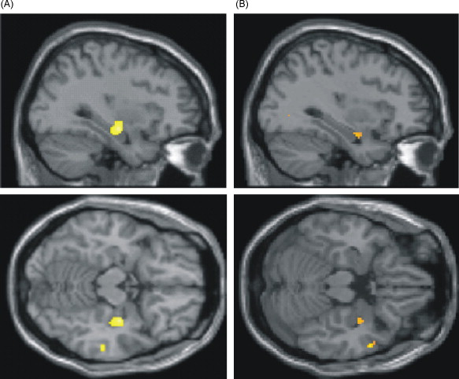
Neurobiology of Spatial Cognition
Plasticity and Experience
Children’s spatial abilities and episodic memory develop in parallel
Allocentric mapping emerges gradually across early childhood
Reflects hippocampal maturation and experience-driven learning
Notes:
The hippocampal mapping system isn’t fixed at birth or even in childhood—it stays remarkably plastic throughout life.
Experience, training, and environmental richness all reshape how these circuits function and even how they’re structured.
One famous example comes from the London taxi driver study.
To earn a cab license, drivers must master “The Knowledge” — memorizing thousands of streets and routes across the city.
MRI studies by Eleanor Maguire and colleagues showed that these drivers had larger posterior hippocampi,
the region most involved in spatial mapping.
The degree of enlargement scaled with years of experience
— clear evidence that sustained navigation can physically remodel the brain.
But this isn’t just about professionals.
Everyday experience matters too.
Training on wayfinding tasks, virtual mazes, or 3D video games improves spatial memory and can increase functional connectivity within hippocampal–entorhinal circuits.
Even moderate exploration of new environments seems to enhance memory flexibility — possibly because it exercises the same updating and integration processes used for episodic recall.
In short, exploration continues to shape the brain’s internal maps long after development.
Whether you’re a child learning your neighborhood, an adult mastering city routes, or just wandering through a virtual world, the hippocampus keeps redrawing the landscape of experience.

Slide 16
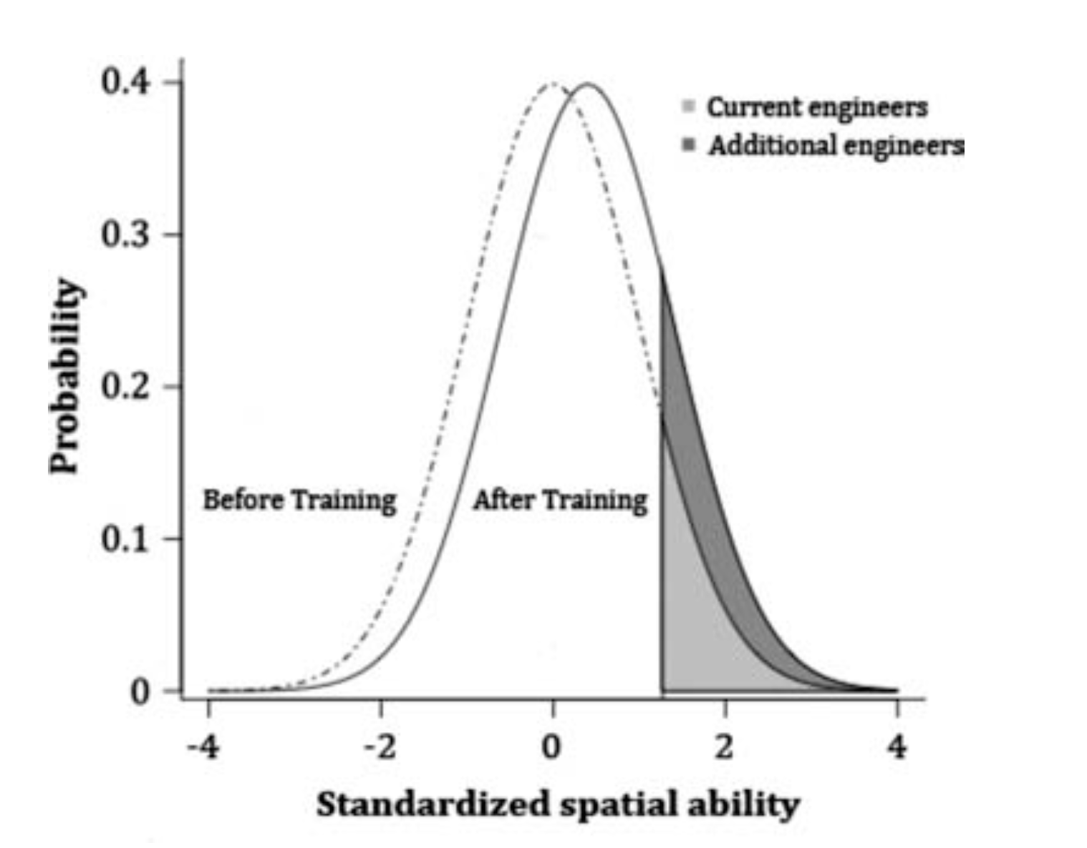
Neurobiology of Spatial Cognition
Can Spatial Ability be Improved?
Uttal et al (2013) show spatial skills can be improved through training
Benefits transfer across tasks and persist over time
Most effective programs involve active, varied practice
Notes:
We’ve seen that experience can physically reshape the hippocampus — but what about training?
A major meta-analysis by Uttal and colleagues (2013) reviewed over 200 studies on spatial skill interventions and found consistent, moderate improvements in spatial ability across participants.
Importantly, these gains weren’t limited to the specific task people practiced.
Training on mental rotation, navigation, or perspective-taking often transferred to other spatial skills — suggesting they tap into shared cognitive and neural processes.
Even more encouraging, these effects lasted: retention was strong weeks or months later.
However, not all training was equal.
The biggest improvements came from active, hands-on practice that required generating and transforming spatial information — not just passively viewing examples.
For instance, manipulating 3D models, solving navigation puzzles, or learning via interactive computer tasks all outperformed static instruction.
Together with the neuroimaging work we just discussed, these results show that spatial cognition is one of the most trainable domains in human cognition — a flexible system continually refined by both experience and deliberate practice.

Slide 17
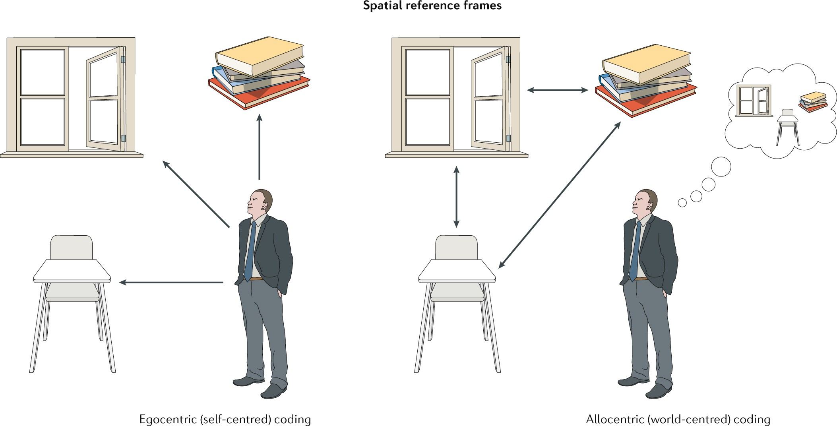
Neurobiology of Spatial Cognition
Disorders of Spatial Cognition
Damage to hippocampal and parietal systems disrupts navigation
Topographical disorientation: intact perception, lost “sense of place”
Spatial deficits reveal how maps anchor memory and self-location
Notes:
When the spatial mapping system is damaged, the result isn’t blindness or paralysis—it’s a loss of orientation.
People can still see, recognize landmarks, and move their bodies, yet feel profoundly lost in familiar environments.
One example is topographical disorientation, often following right hippocampal or parahippocampal damage.
Patients can describe individual landmarks—“there’s the church,” “there’s the bridge”—but can’t link them into a coherent map.
It’s as if the coordinates have dissolved, leaving isolated fragments without spatial relationships.
Lesions in posterior parietal cortex can lead to spatial neglect, where patients ignore one side of space entirely—failing to eat food on the left half of a plate or draw the left side of a clock.
These disorders reveal how perception, attention, and mapping must all coordinate to maintain a sense of location.
Even subtler disruptions can occur in psychiatric conditions.
Individuals with schizophrenia or dissociation sometimes describe distortions of spatial or bodily self-location—perhaps reflecting instability in the same circuits that link internal models to external cues.
By examining these breakdowns, we learn what’s normally automatic:
that feeling of knowing where you are—in the world, in memory, and in your own body—depends on the coordinated integrity of the hippocampal–parietal mapping network.

Slide 18
Neurobiology of Spatial Cognition
Comparative and Clinical Insights
Spatial mapping systems are evolutionarily conserved
Different species adapt shared circuits for unique navigation needs
Comparing across species clarifies what’s fundamental vs. derived
Notes:
To really understand the spatial mapping system, it helps to look both below and beyond humans — across species and across conditions.
From fish to mammals, the basic architecture of spatial navigation remains remarkably similar.
Teleost fish, for example, show hippocampal-like activity that supports allocentric mapping and route integration.
Birds, especially those that migrate long distances, have expanded hippocampal regions that scale with navigational demand.
Even bats and rodents share homologous grid-cell systems, though the geometry of their maps differs depending on how they move — crawling, flying, or swimming.
These cross-species comparisons reveal which parts of the mapping system are evolutionarily conserved — the integration of movement, direction, and boundaries — and which are adaptive elaborations, like using magnetic fields or celestial cues.
Clinical work in humans echoes this pattern of continuity.
Patients recovering from hippocampal strokes or early dementia often rely more heavily on egocentric strategies, much as simpler vertebrates do.
By studying these regressions, neuroscientists can infer what the earliest spatial systems might have been capable of — and what later evolutionary steps added.
So across both evolution and pathology, the same lesson appears:
the ability to form an internal map of space is not uniquely human, but a deeply rooted biological solution to a universal problem — how to move through a world that changes as you do.

Slide 19
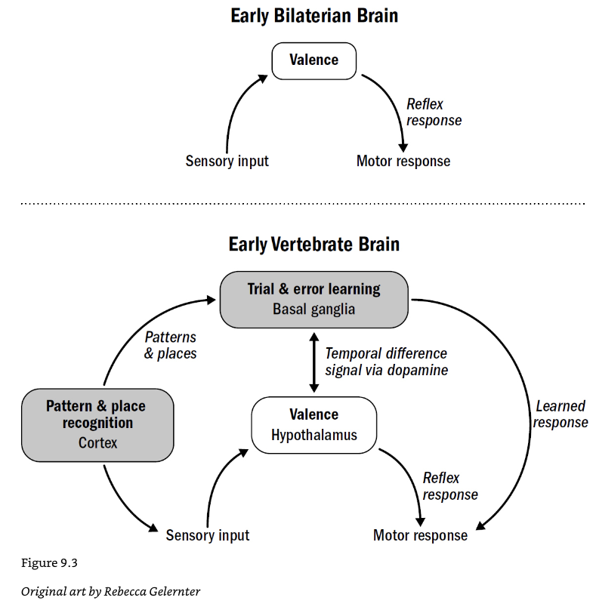
Neurobiology of Spatial Cognition
Spatial Maps and Predictive Brains
Spatial mapping may be the evolutionary origin of prediction
Maps let brains simulate outcomes before acting
From navigating space to navigating possibility
Notes:
By now, it should be clear that spatial cognition does more than help an organism find its way around.
It represents one of evolution’s first great experiments in prediction.
A spatial map isn’t just a record of where things are — it’s a model that can be used to simulate where things will be.
When an animal pauses before turning down a path, or a person imagines which route will get them home faster, the brain is running a kind of internal simulation: a predictive test of action outcomes.
This predictive power generalizes far beyond physical navigation.
Many cognitive scientists now view the spatial map as an early prototype of the brain’s more general modeling capacity — the ability to mentally “move” through abstract spaces: timelines, concepts, or even social relationships.
Just as grid cells provide a coordinate system for physical space, other brain regions may use analogous patterns to organize non-spatial domains — from sound frequency to semantic meaning.
In that sense, the hippocampal–entorhinal system offers a glimpse of how the brain became a predictive engine:
starting with mapping the external world, then expanding to map memory, imagination, and thought itself.
Spatial cognition wasn’t the end of that story — it was the first chapter.

Slide 20
Spatial Cognition and Curiosity
Recap
Spatial cognition evolved to support predictive navigation
Cognitive and neural maps encode relations, not just places
Mapping space laid the groundwork for mapping experience
Up Next
How the brain maps time and experience — Memory
Spatial cognition as the bridge between perception and thought
Notes:
This week we’ve followed a long arc—from the earliest organisms that could move toward or away from signals, to animals that could build internal maps of their worlds.
In Lecture 1, we saw why reactive and reinforcement-based learning alone were not enough.
Organisms gained a huge advantage once they could represent space itself—distinguishing between changes caused by their own movement and those caused by changes in the environment.
In Lecture 2, we explored how cognitive and computational systems represent these relationships:
how humans reason about layouts, imagine transformations, and balance exploration with exploitation.
These algorithmic descriptions showed us that navigation is as much about inference as movement.
And today, we saw how these same principles are realized in the brain — through interacting networks of place, grid, head-direction, and boundary cells, forming a dynamic map that underlies both navigation and memory.
Taken together, spatial cognition marks a major evolutionary turning point:
the emergence of internal models — systems that predict, plan, and imagine before acting.
Once brains could model space, it was only a short step to modeling time, events, and ultimately, experience itself
This week we’ve explored how the ability to move through space led to the ability to model it.
We saw how internal maps help organisms track themselves, predict outcomes, and remember where things happened.
Over evolution, those same neural systems expanded—from mapping physical layouts to mapping the flow of experience itself.
Next week, we’ll turn directly to memory—the next stage of that progression.
We’ll ask how the brain records and replays events over time, how context shapes recall, and how similar mechanisms that once mapped space came to organize experience.
In that sense, spatial cognition sits right at the bridge between perception and thought:
it’s where acting in the world becomes imagining within it.

